Slide 1
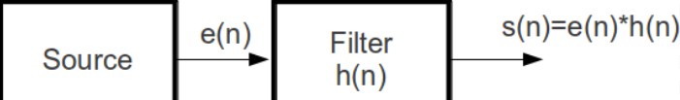


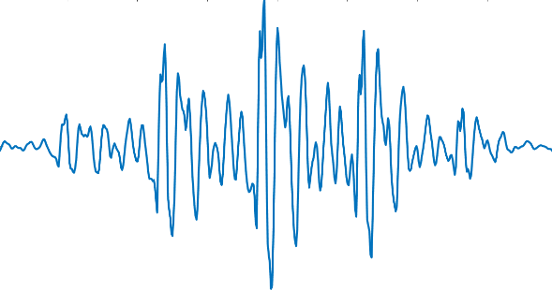
CEPSTRUM ANALYSIS OF SPEECH SIGNALS
ELL205
PROJECT
RIDHIMA GUPTA 2021EE30719
KHUSHIKA SHRINGI 2021EE10665

Slide 2
CONTENTS
OBJECTIVE
OUR APPROACH TO CEPSTRUM ANALYSIS OF SPEECH SIGNALS
WORK PLAN
MATLAB SIMULATION
MATLAB PLOTS
CONCLUSION
REFERENCES

Slide 3
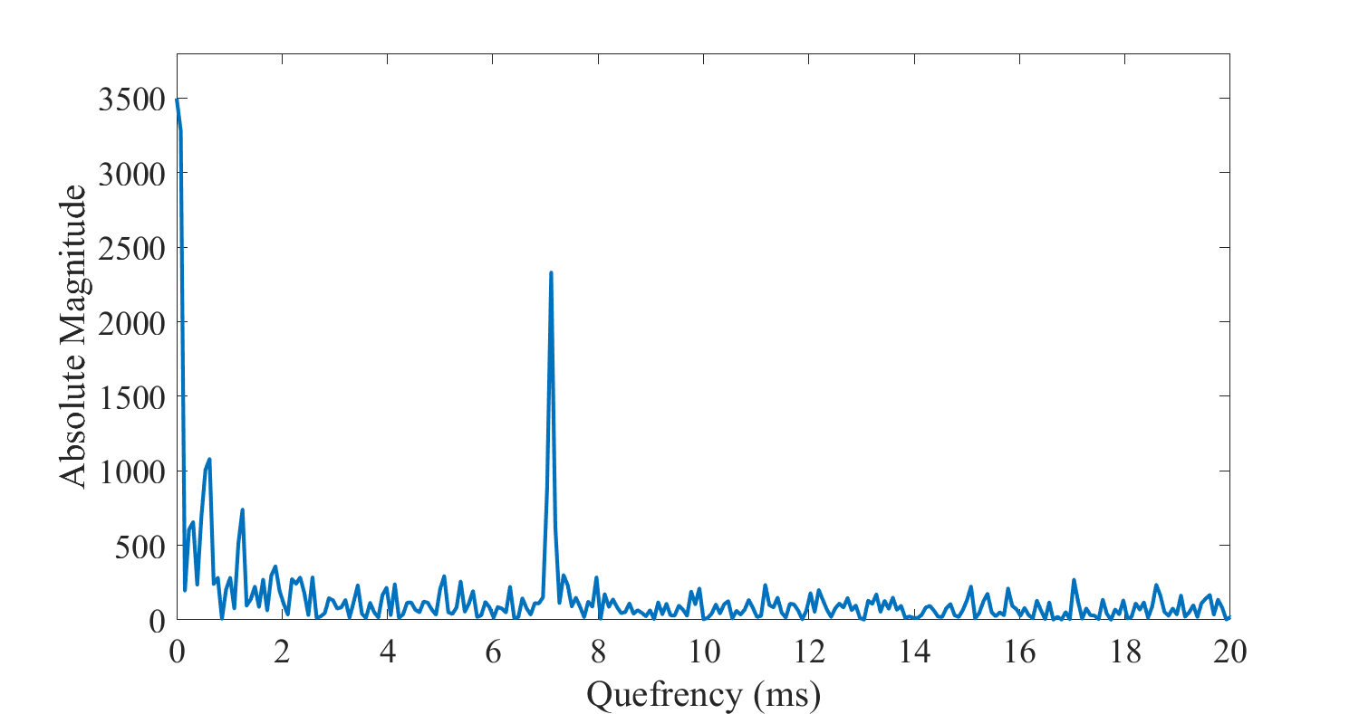
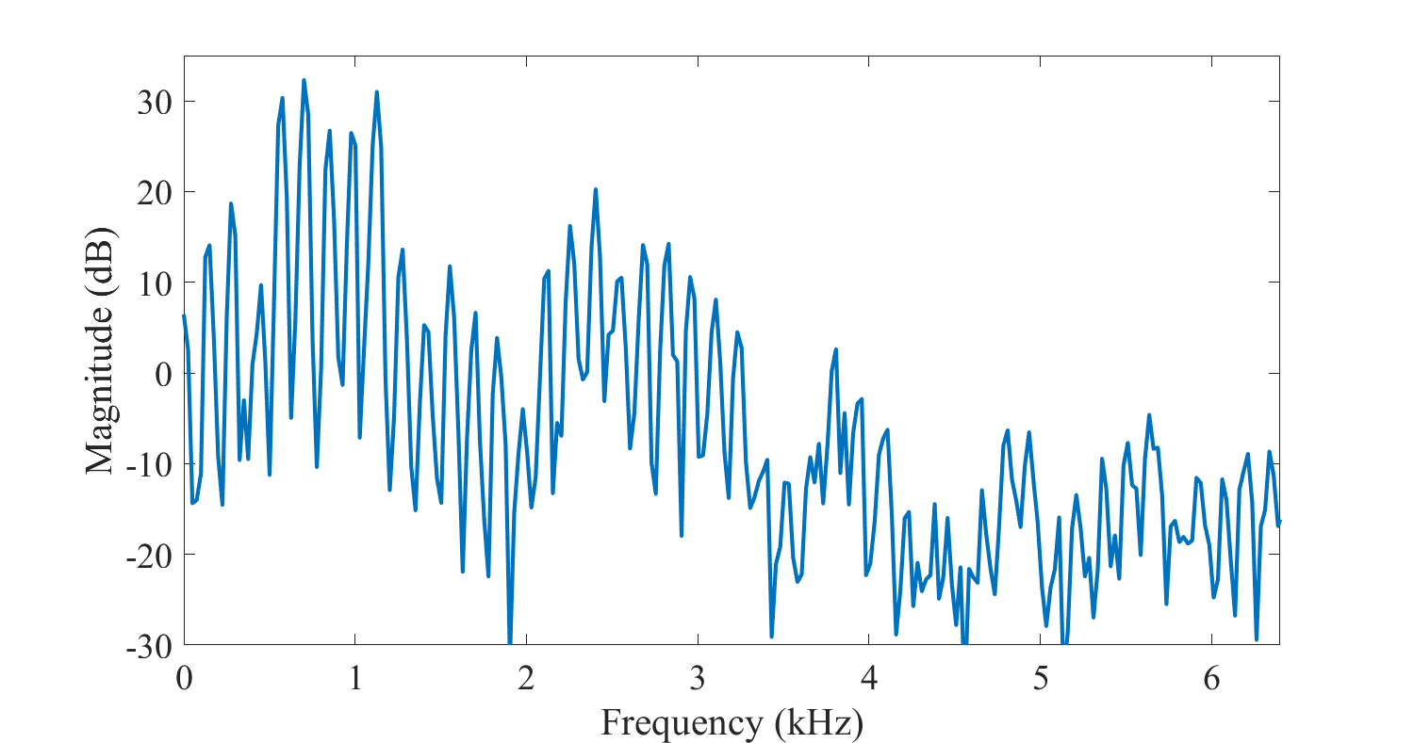
OBJECTIVE
1
To understand Cepstral Analysis of speech signals
2
To analyse speech signals by computing the Cepstrum

Slide 4
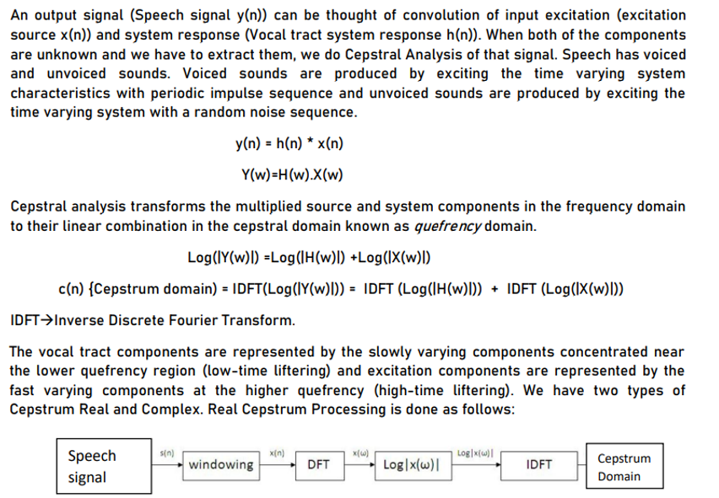
OUR APPROACH TO CEPSTRUM ANALYSIS OF SPEECH SIGNALS

Slide 5

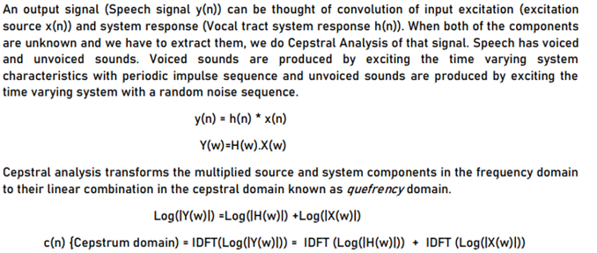
WORK PLAN
1
Exploring Theoretical and practical aspects.
2
Collection of sample speech signals:
We collected few samples of voiced sounds including a , e , i for analysing their Cepstrum.
Link:
https://drive.google.com/drive/folders/1TWftkw7lwG75dVdOXHD49B6MJNcnTwLS?usp=sharing
Notes:
When conducting research, it is easy to go to one source: Wikipedia. However, you need to include a variety of sources in your research. Consider the following sources:
Who can I interview to get more information on the topic?
Is the topic current and will it be relevant to my audience?
What articles, blogs, and magazines may have something related to my topic?
Is there a YouTube video on the topic? If so, what is it about?
What images can I find related to the topic?

Slide 6

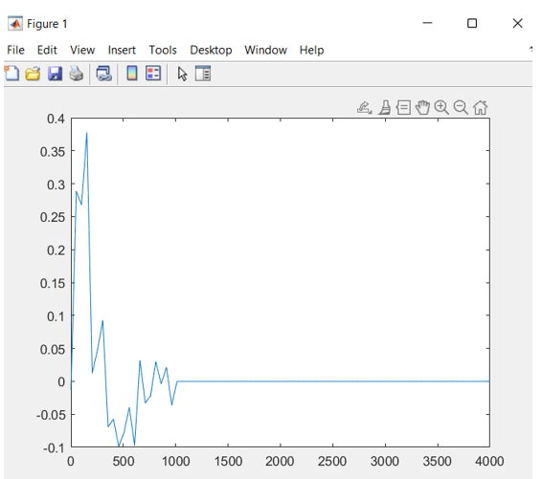
WORK PLAN
3
Learnt MATLAB simulation & Signal Processing
Analysis and Separation of components
4
Notes:
When conducting research, it is easy to go to one source: Wikipedia. However, you need to include a variety of sources in your research. Consider the following sources:
Who can I interview to get more information on the topic?
Is the topic current and will it be relevant to my audience?
What articles, blogs, and magazines may have something related to my topic?
Is there a YouTube video on the topic? If so, what is it about?
What images can I find related to the topic?

Slide 7

MATLAB SIMULATION
In the next slides, We have demonstrated the analysis of Cepstrum and the separation of the source/excitation and the vocal tract component componentof the voiced sound “a.wav”
Notes:
After consulting a variety of sources, you will need to narrow your topic. For example, the topic of internet safety is huge, but you could narrow that topic to include internet safety in regards to social media apps that teenagers are using heavily. A topic like that is more specific and will be relevant to your peers. Some questions to think about to help you narrow your topic:
What topics of the research interest me the most?
What topics of the research will interest my audience the most?
What topics will the audience find more engaging? Shocking? Inspiring?

Slide 8
MATLAB CODE
[smpl,fs]=audioread('a.wav');%Read the audio speech signal input. We took vowel 'a'.
smpl = resample(smpl(8801:9760,1),8000,48000);%Resampling the audio signal
subplot(8,1,1);plot(linspace(0,4000,80),smpl(1:80));title('sample');
%First we calculated the real cepstrum of the input wave using the inbuilt rceps model
ft=rceps(smpl);subplot(8,1,2);plot(linspace(0,4000,80),ft(1:80));title('rceps');
%Calculating the Fast Fourier Transform of the Sample
ft1=fft(smpl);subplot(8,1,3);plot(linspace(0,4000,80),ft1(1:80))title('fft');
%Taking log of the transform to convert the product into sum of the vocal tract and excitation component
lg=log(abs(ft1));subplot(8,1,4);plot(linspace(0,4000,80),lg(1:80));title('logabs');
%Taking Inverse Transform to get into the cepstrum domain
ift=ifft(lg);subplot(8,1,5);z=ift;plot(linspace(0,4000,80),ift(1:80));title('ifft');
%The Source excitation occurs at higher frequency So we replaced the lower frequency samples with zeroes
ift(1:21,1) = 0;%Source Excitation ;subplot(8,1,6);plot(linspace(0,4000,80),ift(1:80));title('source');
%The vocal tract component occurs at lower quefrencies. Thus Replacing with zeroes at higher quefrency
z(21:160,1) = 0;%Vocal Tract Component ; subplot(8,1,7);plot(linspace(0,4000,80),z(1:80));title('vocal');
Notes:
Once you find your sources, you will want to evaluate your sources using the following questions:
Author:
Who is the author?
Why should I believe what he or she has to say on the topic?
Is the author seen as an expert on the topic? How do you know?
Current:
How current is the information in the source?
When was the source published?
Is the information out-of-date?
Accuracy:
Is the content accurate?
Is the information presented objectively? Do they share the pros and cons?

Slide 9
PITCH

Slide 10
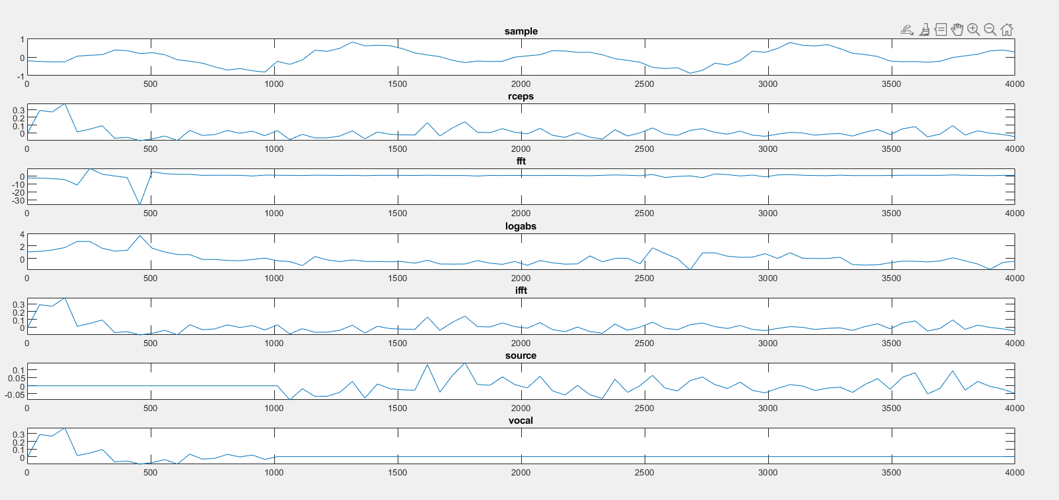
Notes:
Now, that you have narrowed your topic, you will want to organize your research in a structure that works. There are some common organizational patterns based on the kind of research you are doing.
Organizational Structures:
Cause and Effect- this kind of structure is great for explaining the causes and effects of a topic
Compare and Contrast- in this pattern you highlight the similarities and differences of the topic
Explain process- this structure is great for outlining a series of steps to follow;
Definition- if you want to make sure your audience understands what something is using illustrations, meanings, clarifying misconceptions, you may want to use this structure
Classification- a common organizational structure is grouping like topics or facts from the research together. For instance, in the internet safety about social media apps, you may organize the research where you look at each social media app one at a time

Slide 11

CONCLUSION
Thus , We extracted the source/excitation component(characterising words spoken and the pitch) and vocal tract components(characterising the quality of speech) from the given speech signal by linear separation of the convolved signal which is known as liftering. We didn’t had any earlier knowledge of these components and their deconvolution would have been a tedious task due to their uncertainity.
But due to the linear separation in cepstrum domain(quefrency), We could trace back these components by knowing their concentration at higher and lower quefrency regions.
We concluded that we can apply this Cepstrum Analysis in various domains which includes recognition of the speech samples.Not only this we could even use it to detect certain respiratory diseases by analysis the coughing samples of an individual, a boon in COVID era for early detection. We can detect faults in the defective machines from their noise spectrum and can get the location of defect.Thus, Cepstral Analysis has a wide range of applications.
Notes:
After you’ve done your research, it’s time to put your presentation together. The first step in the process is to introduce the topic. This is a great time to connect your topic to something that your audience can relate. In other words, why should they listen to all the information you will be sharing in your research presentation? What is in it for them? You may also want to include a graphic or image to grab their attention.
Feel free to duplicate this slide by right-clicking on this slide in the slides pane to the left and select Duplicate Slide.
The next step in your presentation is to state your claim or topic clearly. Your teacher may even call this your thesis. As you state your thesis, you may find that this layout is not the best layout for your claim or topic. You can change the layout by clicking the drop-down menu next to the Layout in the Slides menu section. You can choose Two Content, Comparison, or Picture with Caption. Note: A different layout might change the look of the icons on this page.
You will also want to state your facts. You have done the research now share some of the interesting facts with your audience. Facts do not have to be boring; you can communicate facts in a variety of ways by going to the Insert Tab. In the Insert tab you can:
Insert pictures from your computer or online.
Add a chart
Create some SmartArt
Insert a variety of icons to help your facts come to life. Note: You can change the color of the icons by selecting the icon and then click on the Format tab and then Graphics Fill. From there, you will choose a color from the list or choose More Fill Colors to give you more options.
Since this research presentation is a result of your hard work and searching, you want to make sure you support the claims or points in your presentation with facts from your research findings. Make sure you give the author proper credit for helping you share your ideas. If one of your sources has a video that is relevant to your topic, you can add the video as added support. Keep in mind the length of the video and the amount of time you have for your presentation. For a 5 minute speech, the video should be no longer than 30 seconds.
Questions to consider:
How will you state the author of the source?
Will you need to cite the source on the slide?
What are some ways you can engage your audience so they feel like they are a part of the presentation? Some ideas to consider is by taking a quick poll like: by a show of hands, how many of you think school uniforms are a way to cut down on bullying? Another suggestion is to have them hold up a certain number of fingers to see if they agree or disagree. Finally, you can share a story that the audience can relate to that makes them laugh.
After all the applause, your audience may have some questions. Be prepared to answer some of their questions by making a list of questions you think they might ask. You may also want to share the presentation with them by providing the link to your presentation, if they want more information.

Slide 12
REFERENCES
https://ssp-iiith.vlabs.ac.in/exp/cepstral-analysis/index.html
https://en.wikipedia.org/wiki/Cepstrum
http://www.xavieranguera.com/tdp_2011/8-Cepstral-Analysis.pdf
https://www.youtube.com/watch?v=wEoNuCxMv0U
https://in.mathworks.com/help/signal/ref/rceps.html

Slide 13
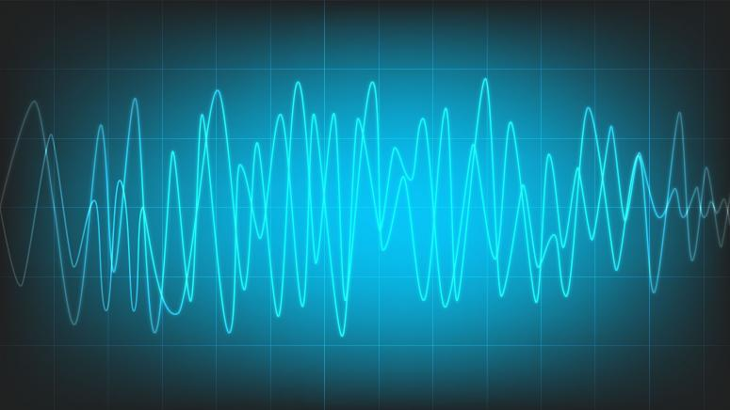
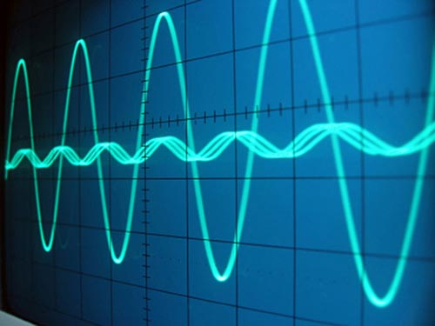


THANK YOU
RIDHIMA GUPTA 2021EE30719 KHUSHIKA SHRINGI 2021EE10665
Notes:
You can use this slide as your opening or closing slide. Should you choose to use it as a closing, make sure you review the main points of your presentation. One creative way to do that is by adding animations to the various graphics on a slide. This slide has 4 different graphics, and, when you view the slideshow, you will see that you can click to reveal the next graphic. Similarly, as you review the main topics in your presentation, you may want each point to show up when you are addressing that topic.
Add animation to images and graphics:
Select your image or graphic.
Click on the Animations tab.
Choose from the options. The animation for this slide is “Split”. The drop-down menu in the Animation section gives even more animations you can use.
If you have multiple graphics or images, you will see a number appear next to it that notes the order of the animations.
Note: You will want to choose the animations carefully. You do not want to make your audience dizzy from your presentation.

